Slide 1
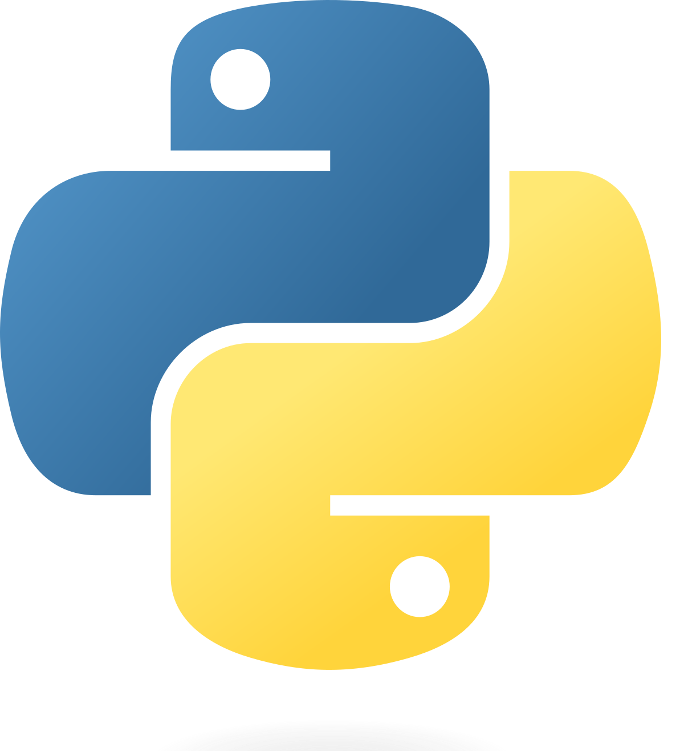
PY01: Introduction to Python
Notes:
Maybe we can have an accompanying Jupyter Notebook?

Slide 2
Timings
0 - 30 minutes in: Presentation
30 - 60 minutes: Task

Slide 3
Workshop overview
In this workshop we’re gonna cover the very basics of Python:
What is Python?
Python’s applications to data science
Text editors / IDEs
Jupyter Notebook
“Hello, world!”
Variables
Data types
Arithmetic Operators
If Statements
Lists
Iteration(?)
Functions(??)

Slide 4
What is Python?
Python is a high-level programming language that is used for a huge range of purposes
A high-level language is something that is close to human language, but needs to be translated for computers
Python has been used to create:
Useful applications such as Anki and Dropbox
Games like World of Tanks and the Sims 4
Web Frameworks such as Google App Engine to develop web applications
Python Libraries such as TensorFlow, SciPy, and Pandas
https://en.wikipedia.org/wiki/List_of_Python_software

Slide 5
Python and Data Science
Why do people like to use Python?
Easy to learn
Most popular language → Large community of programmers online that can help you!
Loads of libraries, makes coding very easy since a lot of the work may have already been done for you
In Data Science, Python is often used for
Visualising data (Matplotlib)
Analysing data
Machine learning (TensorFlow)

Slide 6
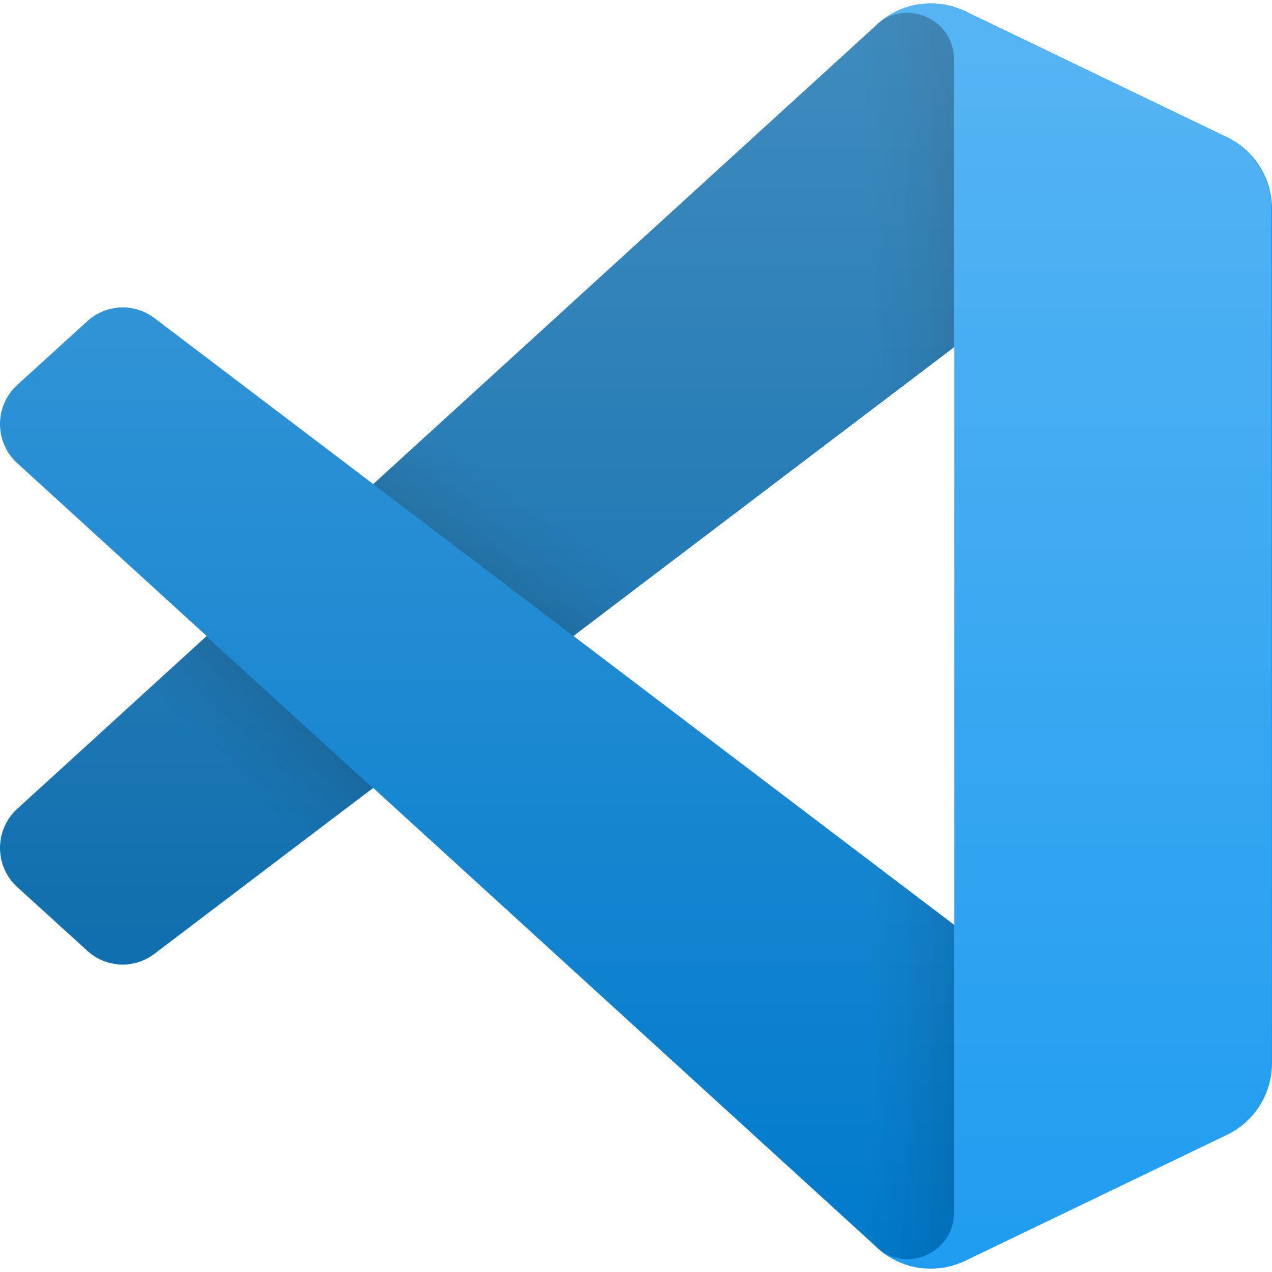
Python Text Editors / IDEs
Of course, we can just use command prompt to code Python, but that’s impractical.
Oftentimes, we use a text editor (such as Notepad++, or VSCode), or an IDE (Integrated Development Environment).
The main difference is that IDEs tend to have more features and can be more useful for big projects
Text editors use less memory
It all comes down to preference, really!
Today, we’ll have a look at the Jupyter Notebook environment

Slide 7

Jupyter Notebook
Jupyter Notebook is a web-based IDE that allows us to show our code in a more presentable manner.
Code is divided into blocks that can be edited and run separately, and can present equations, images, and text very nicely!

Slide 8
Hello, world!
Let’s start our Python journey with a classic: “Hello, world”
If you have Jupyter Notebook installed, follow along with me!
If not, that’s okay too :^)

Slide 9
Variables
Variables are a way for us to reference to a certain object or value.
Basically, they’re containers for storing something
In Python, we don’t need to declare variables, since a variable is created as soon as we assign it a value.
x = 5
y = “hello!”

Slide 10
Data types
Python has many data types, the ones that are important to us now are integers, floats, booleans, and strings.
We can tell types apart from how they look, or by using the inbuilt type() function
A lot of times, if we use the wrong data type for a variable, it will throw back an error.
For example: using floats instead of integers with looping.

Slide 11
Comparison Operators and using them in “If” Statements
“If” Statements are a huge part of coding, and follow the basic format:
If [condition is True]:
Do this
else:
Do that
How can we write the conditions?
How do we write if statements in python?

Slide 12
Lists
Lists are used to store multiple items in a single variable
There are also other ways to do this, such as with a dictionary, but that’s out of the scope.
Lists are also indexed starting from 0, so in the list:
list = [“a”,“b”,“c”], list[0] = “a”
We can also extract particular parts of a list!

Slide 13
Iteration
For loops are used to iterate a command a number of times, or for every element in a string or list.
While Loops will iterate a command so long as the condition is true

Slide 14
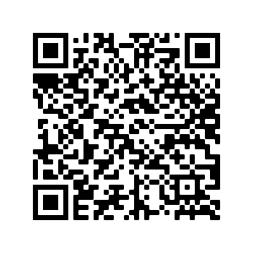
Slides, Python task, and the supplementary notebook:
https://drive.google.com/drive/folders/15SJqg87Vy7giZJdnn_uu6jln857MbD7r?usp=sharing

